Slide 1
Vedenkierron maanalaisia ilmiöitä Phenomena of the low part of water cycle Servo Kasi, HY - Fysiikan laitoksen geofysiikka

Slide 2
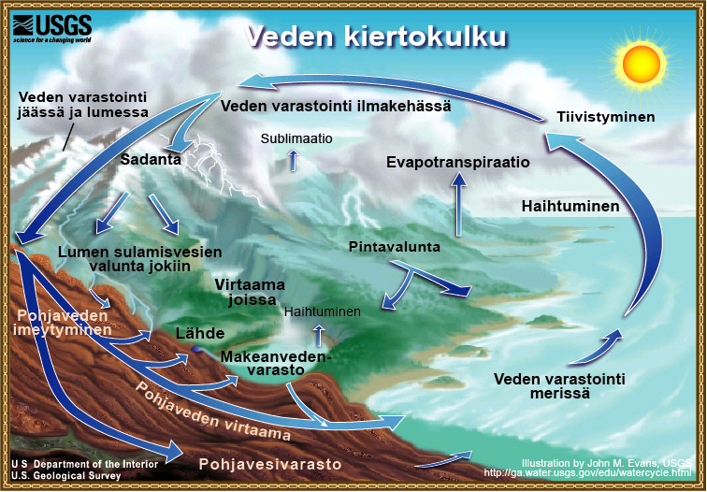

Slide 3
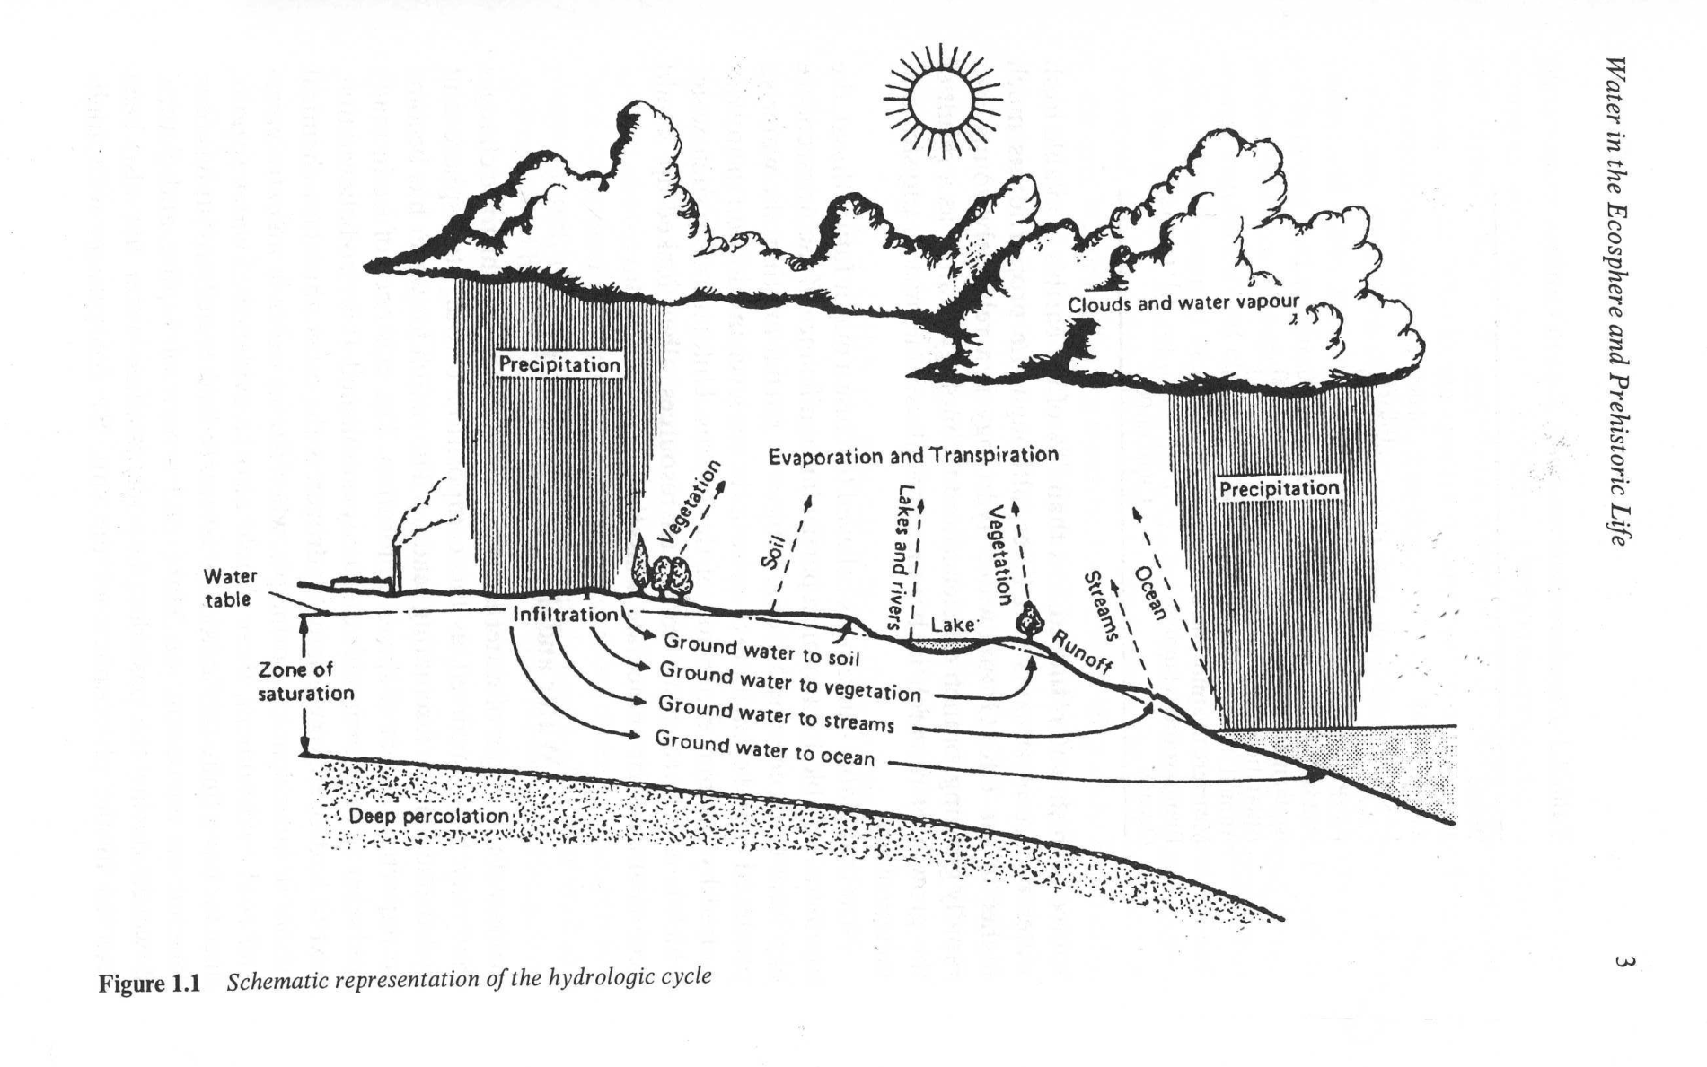
Felix Franks: Water – a matrix of life

Slide 4
Martin Chaplin: Water Structure and Science
http://www.btinternet.com/~martin.chaplin/index.html

Slide 5
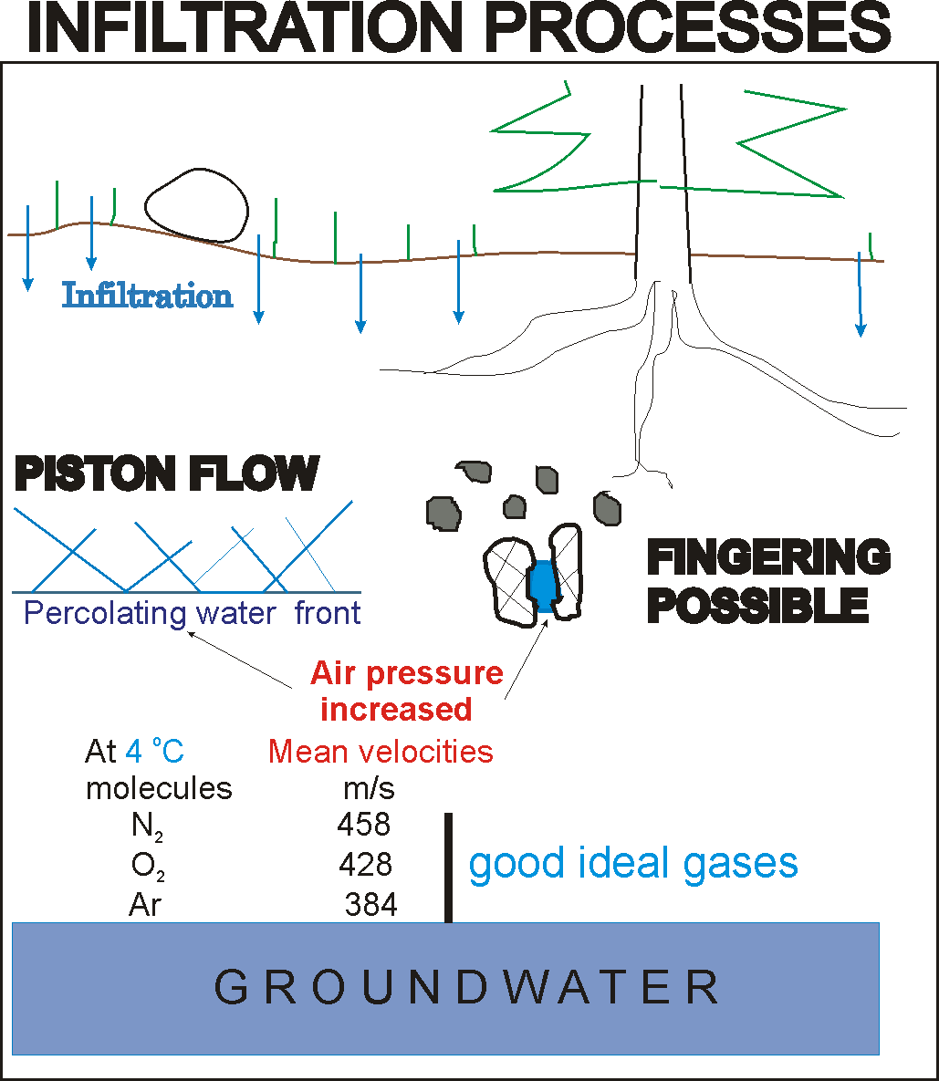

Slide 6
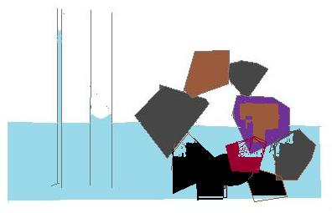
h 1/r
h

Slide 7
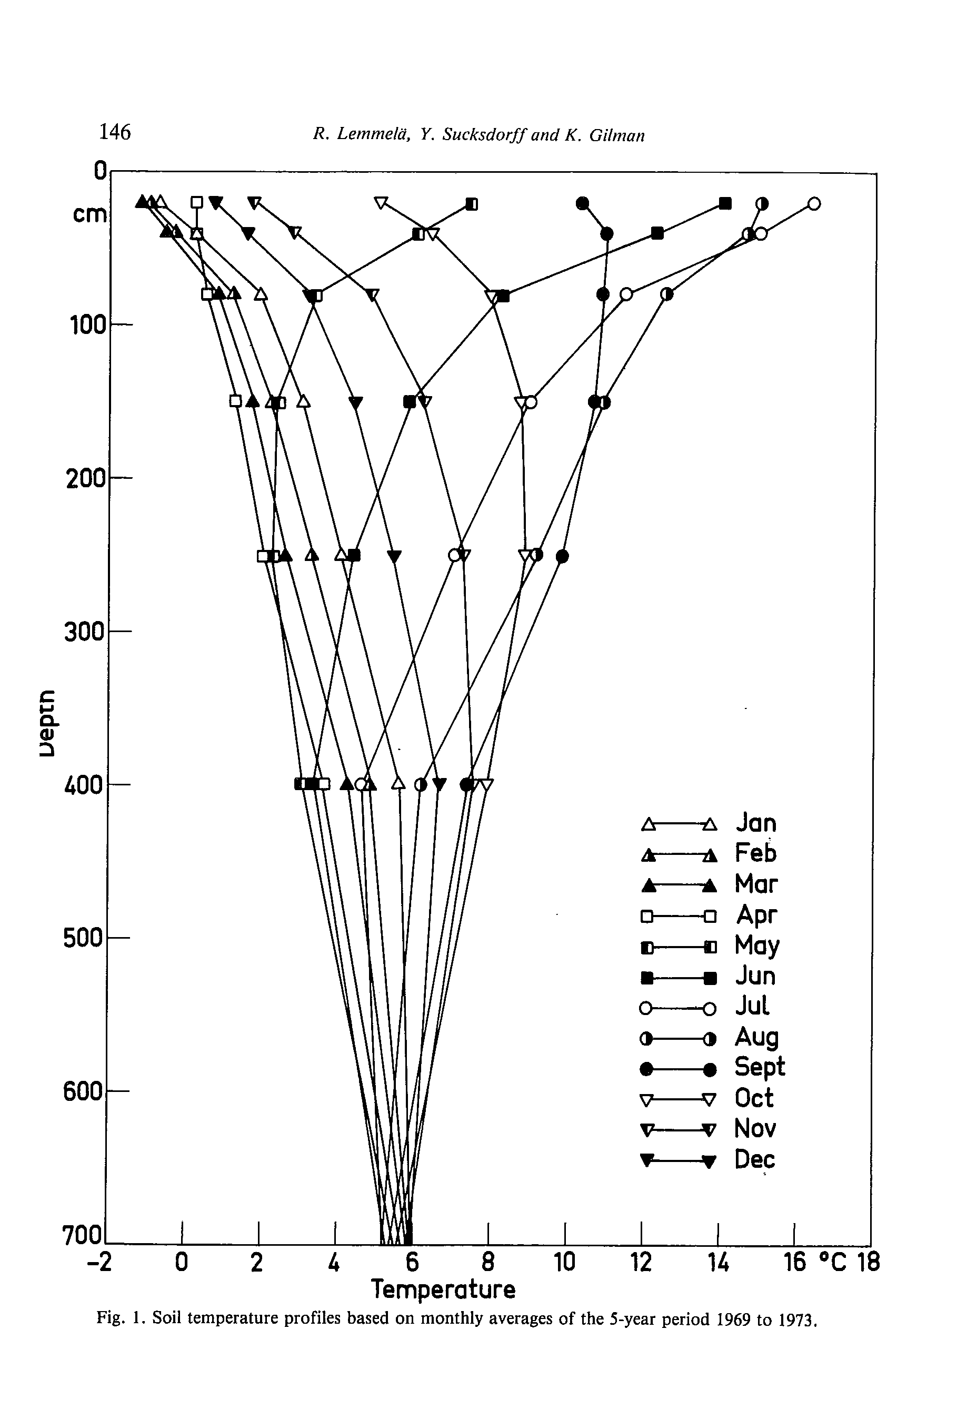

Slide 8
Lemmelä et al. (1981) present the temperature profile in soil
where t is time in years (a).
Which are the values of

Slide 10
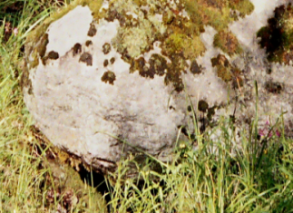
©Lammin Säkiä ry
B
A

Slide 11
Hot wire anemometer

Slide 12
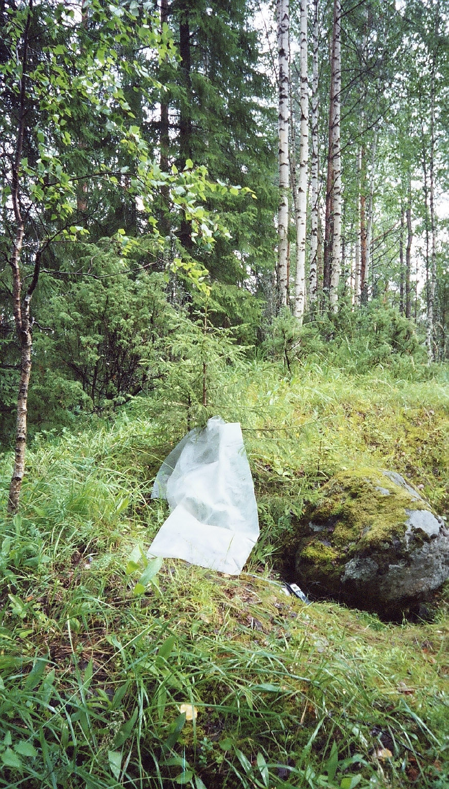

Slide 13
2004
5.8.
30.7.
24.-25.8.

Slide 14
©Lammin Säkiä ry
B
A

Slide 15
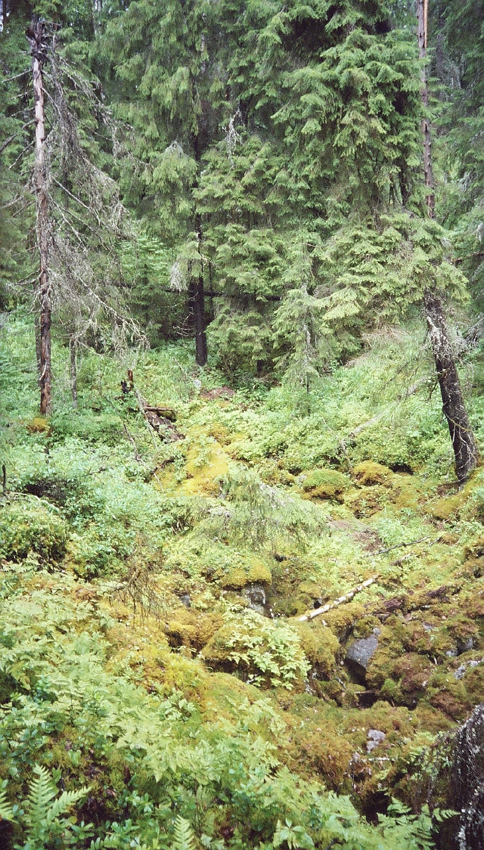

Slide 16
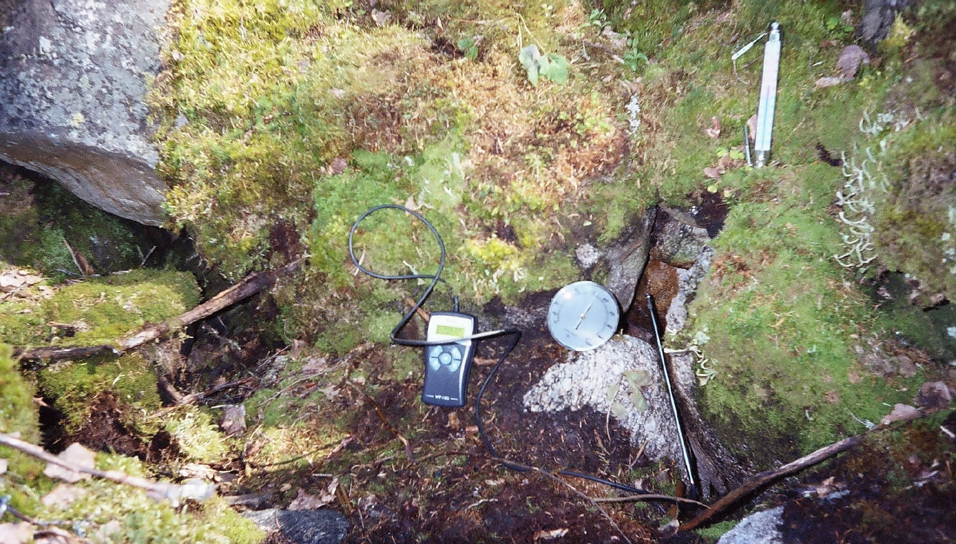

Slide 17

Outflows of air in Mustasuppa pit.
Date 2004 | 30.7. |  |  | 5.8. |  |  | 24-25.8.
 | m/s | ºC | RH% | m/s | ºC | RH% | m/s | ºC | RH%
Holes A | 0.15 | 4.2 | 62 | 0.07-0.22 | 3.6 | 48 | 0.2-.4 | 3.9 | 55
Holes B | No flow |  |  | 0.1-0.55 | 8.8 | 89 | 0.2-0.5 | 5.3
B
A

Slide 18
0

Slide 19
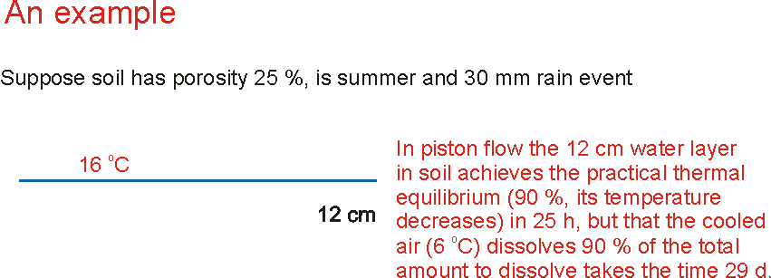

Temperature dependent processes in soil air and water

Slide 20
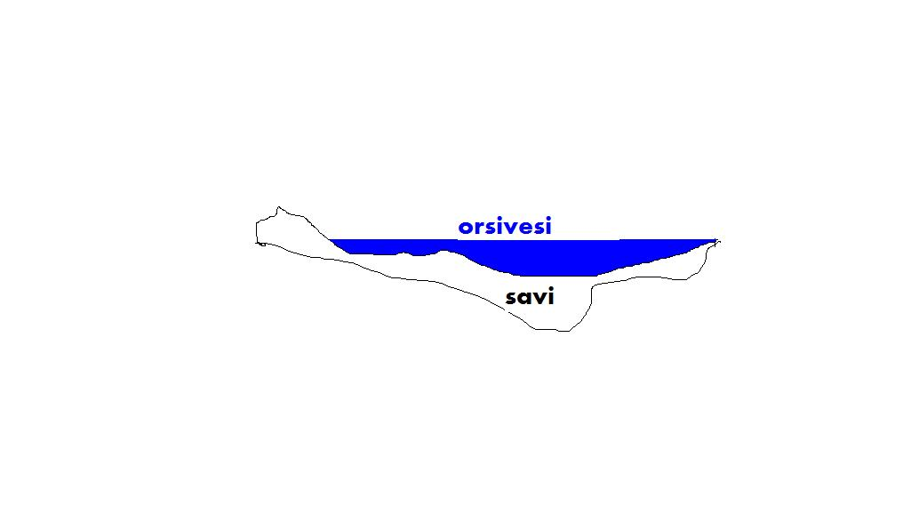

Slide 21
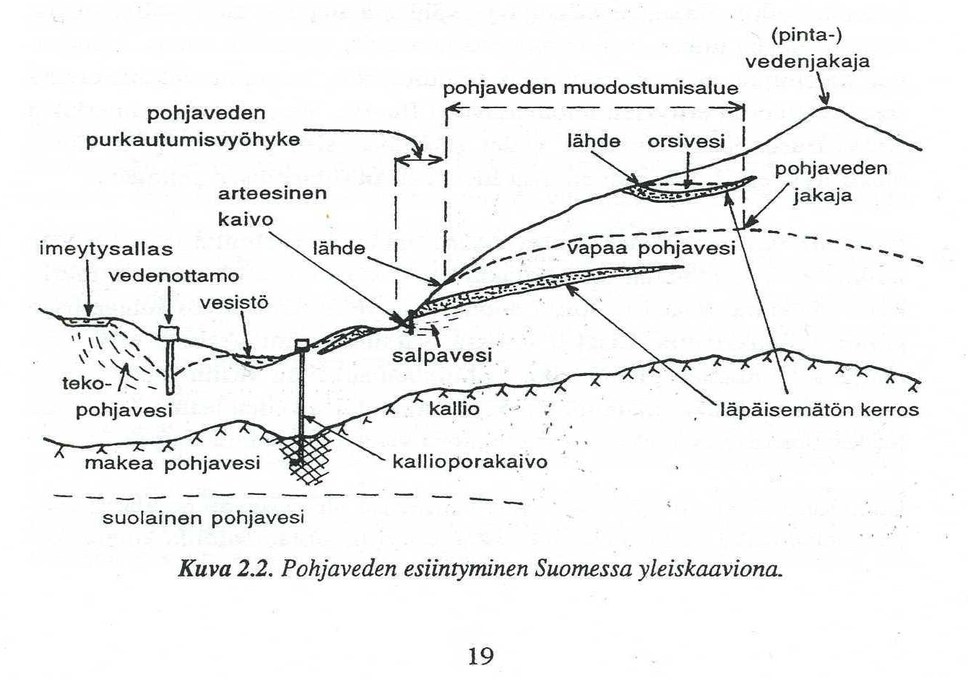
Heikki ja Suvi Niini: Vesigeologia

